Slide 1
Application Controller Pattern
Dmitriy Sinitsyn

Slide 2
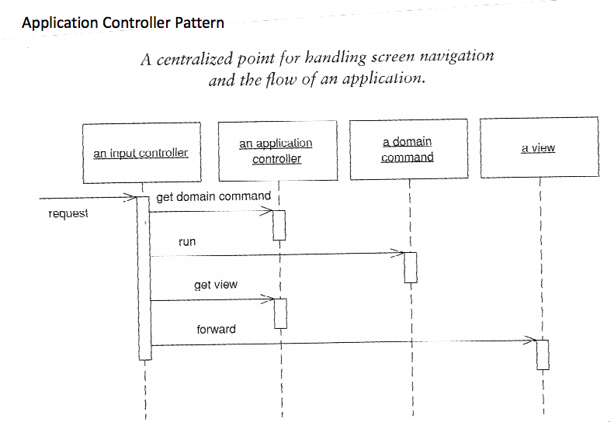

Slide 3
Three kinds of objects are defined: Context, View and Controller.

Slide 4
The context is a structure in which the state of the operation and the data relevant to the flow are stored. Typically its life cycle is the operation itself. The context is composed by two parts, the Control and the Business Context. The control context is composed for those variables whose value determines the navigation but they are not used in the operation being executed (the newCustomer variable in the following example). The business context is composed for those variables that are used by the operation to achieve it goal (Continuing with the same example, the Customer Variable).

Slide 5
The Views (also called steps) are activities displayed according to the logic defined in the activity diagram. Generally, there’s more than one view in an operation. Each view handles the logic of the step it implements, ignoring intentionally the navigation logic. Its communication method is the Context. It reads and writes the Context.

Slide 6
The controller is the component responsible to determine the activity to show according to the Context, the Current View and the activity diagram. It can be generated from the business context and the activity diagram. It also reads and writes the Control Context. Typically it only reads the Business Context.

Slide 7
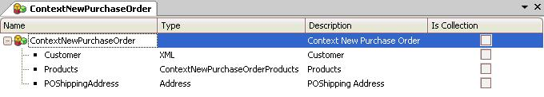

Slide 8
It generates the following objects
NewPurchaseOrder
NewPurchaseOrder is the web panel that implements the operation. It Wraps the different views and stores the current step.
ControllerNewPurchaseOrder
ControllerNewPurchaseOrder is the procedure that implements the navigation logic.
ControlContext
ControlContext is a SDT generated with the necessary information for the controller to choose the following step.

